Slide 1

Full Stack lll - Lecture 6.2
Mongoose CRUD & Queries

Slide 2
Topics
CRUD Operations
Queries

Slide 3
Mongoose Model CRUD

Slide 4
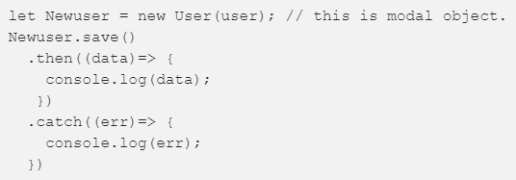
Mongoose CREATE Methods
save() - is used to insert a record in collection. It is used with Model object. ie. we have to create a model object
insert(), insertMany() or create() - are used to insert arrays of records into collection
insertOne() - insert single record in collection, like save() but faster

Slide 5

Mongoose UPDATE Methods
update() - used to update a record based on condition
findOneAndUpdate() - combination of read and update a record in collection
findByIdAndUpdate() - used to update a record based on Id

Slide 6
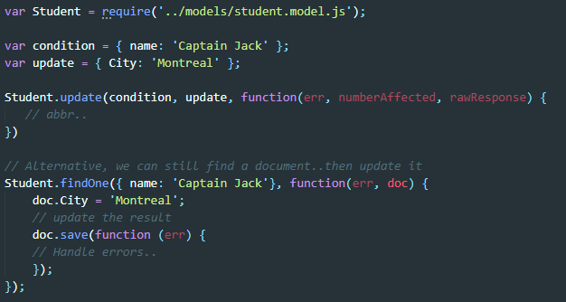
Model.update(conditions, update, [options], [callback])

Slide 7

Mongoose DELETE Methods
delete() - is used to delete a document based on a condition
deleteMany() - used to remove all documents matching given filter

Slide 8
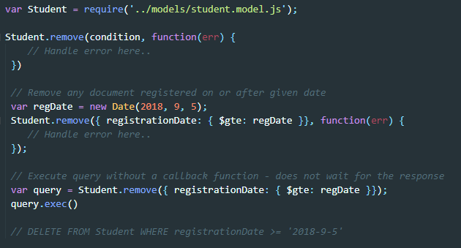
Model.remove(conditions, [callback])

Slide 9
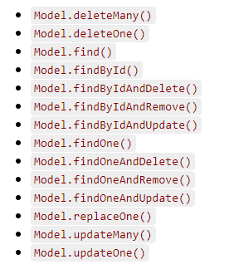
Mongoose Queries
Mongoose models provide several static helper functions for CRUD operations. Each of these functions returns a mongoose Query object.
* Remember CRUD stands for Create, Update, Delete.

Slide 10
Mongoose Queries

Slide 11
Video - Saving Data
Notes:
https://youtu.be/2oYtk83FZCA

Slide 12
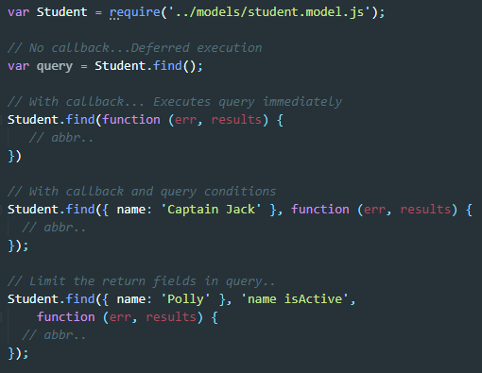
Model.find
Model.find(conditions, [fields], [options], [callback])
The model class exposes several static and instance methods to perform operations on the database ie. fetch
Using find without a callback, will return a query object to be executed at a later time
Using find with a callback will execute the query right away and then handle results or error in callback
Student.find() = SELECT * FROM Students
Student.find({ name: ‘Captain Jack’} = SELECT * FROM Students WHERE name = ‘Captain Jack’

Slide 13
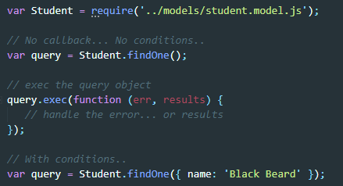
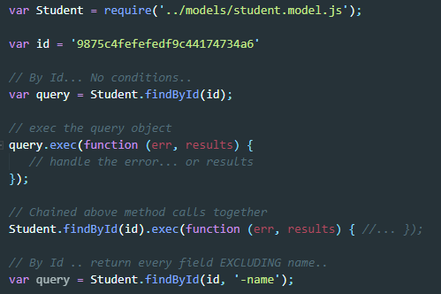
Model.findOne and Model.findById
Model.findOne(conditions, [fields], [options], [callback])
Model.findById(conditions, [fields], [options], [callback])

Slide 14
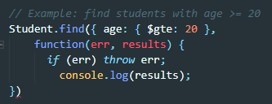
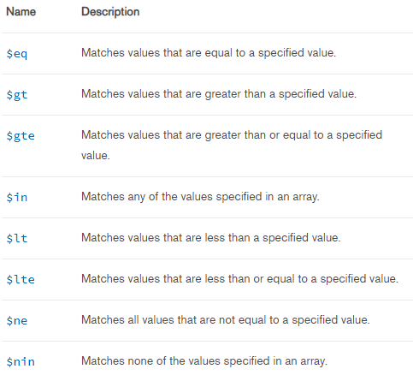
Query Selectors - Comparison Query Operators

Slide 15
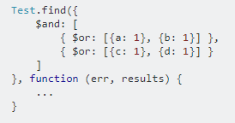

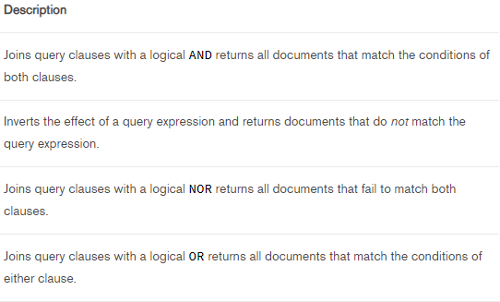
Logical Query Operators

Slide 16
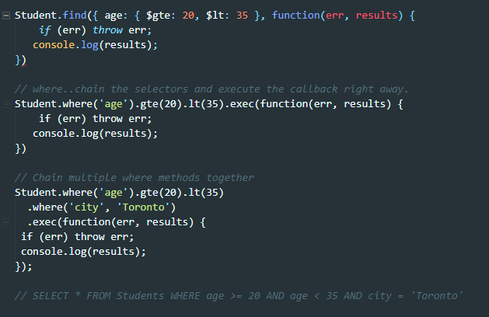
Model.where(path, [val])

